Slide 1
Big Mountain Resort
By Taeisha Morgan

Slide 2
Problem Identification:
The Big Mountain Resort would like a pricing model for resort tickets in their market maximizing its return based on their position in the market and to receive insight on how their facilities are most important to their customers and what facilities their customers are willing to pay for to help Big Mountain Resort with future investments.

Slide 3
Problem Identification:
The Big Mountain Resort would like a pricing model for resort tickets in their market maximizing its return based on their position in the market and to receive insight on how their facilities are most important to their customers and what facilities their customers are willing to pay for to help Big Mountain Resort with future investments.

Slide 4
Problem Identification
There was a strong correlation between summit and base elevation, night skiing, and number of resorts per capita.
There are significant correlations between ticket prices and variables such as snowmaking, vertical drop, projected days open, and the presence of quad lifts.

Slide 5
Recommendation and Key Finding
There was a strong correlation between summit and base elevation, night skiing, and number of resorts per capita.
There are significant correlations between ticket prices and variables such as snowmaking, vertical drop, projected days open, and the presence of quad lifts.

Slide 6
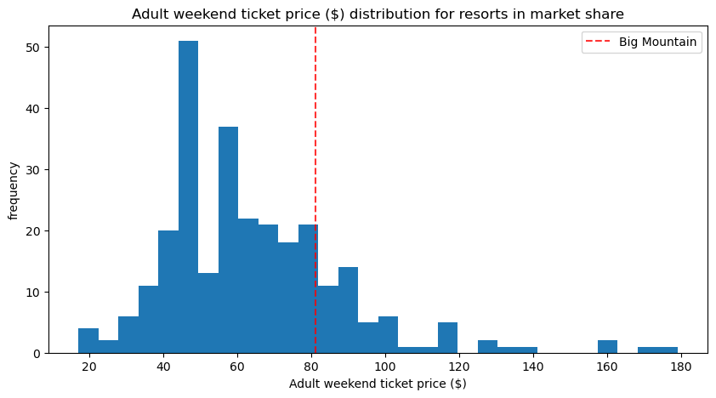
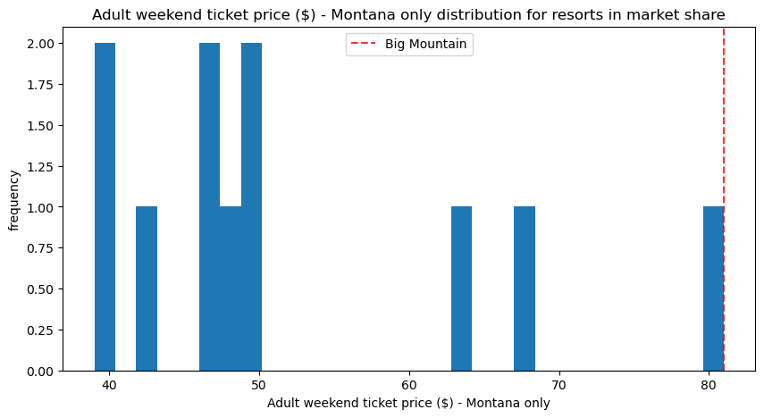
Modeling results and analysis
Big Mountain’s weekend ticket at $80 is on the
higher end of all resorts in the US but closer to the
median price.
Big Mountain has the highest weekend ticket in Montana.

Slide 7
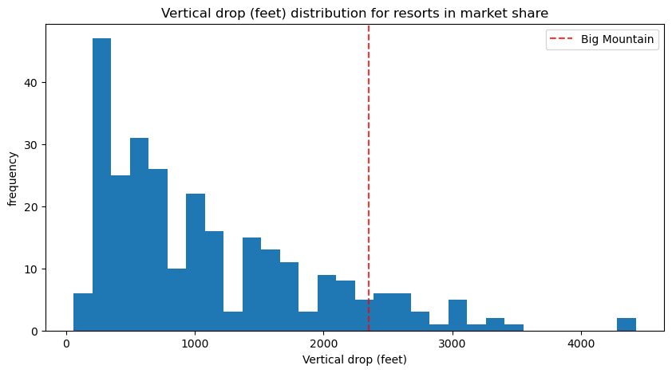
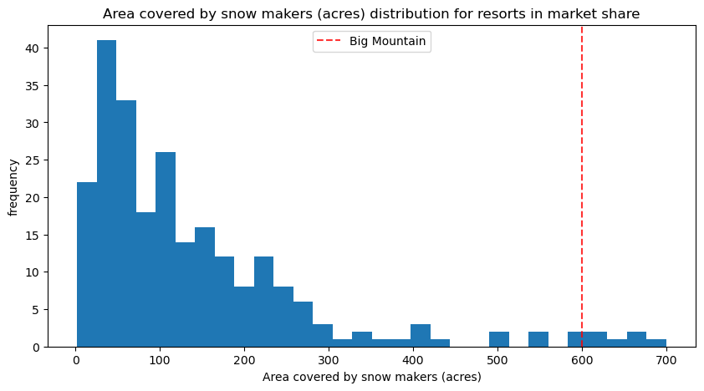
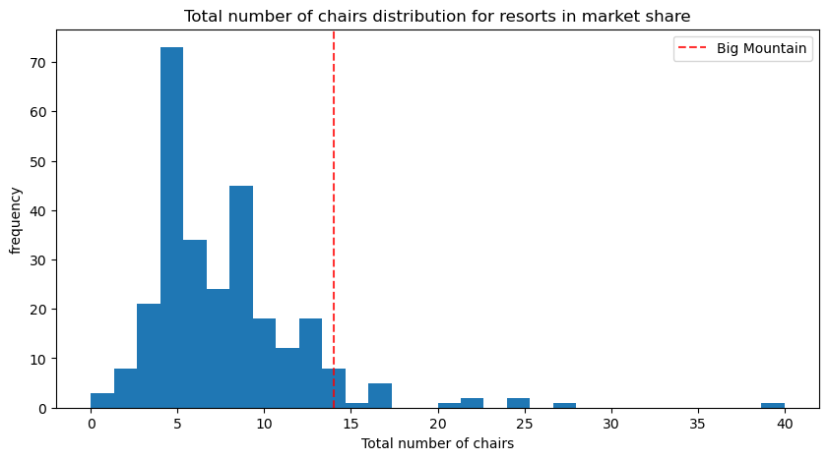
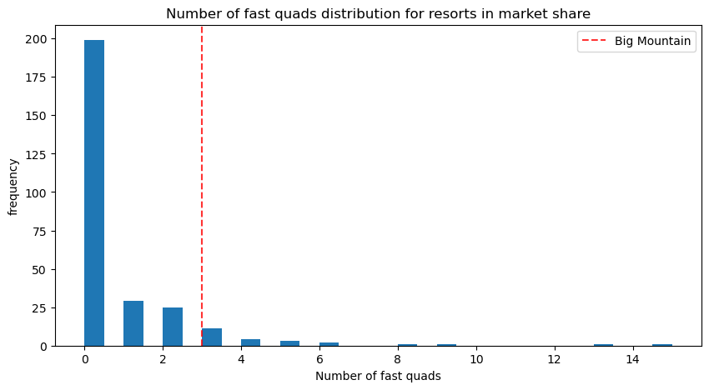
Modeling Results and Analysis
Big Mountain has a great vertical drop and is among the highest resorts.
Big Mountain is amongst the most snow making resorts.
They are amongst the highest number of total chairs.
Most resorts do not have a quad and Big Mountain has 3.

Slide 8
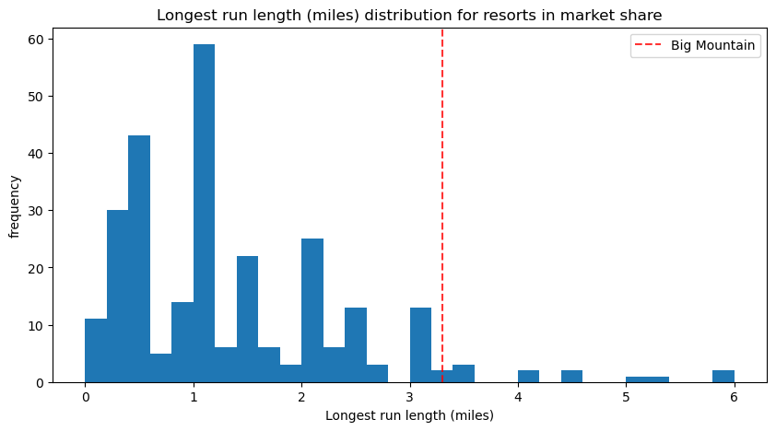
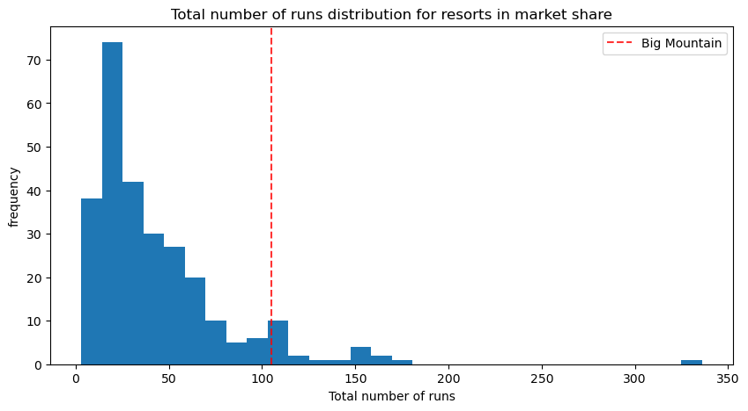
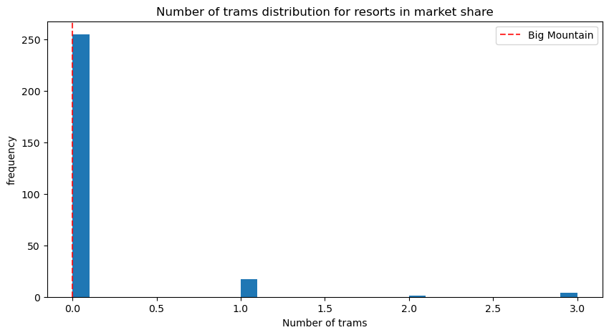
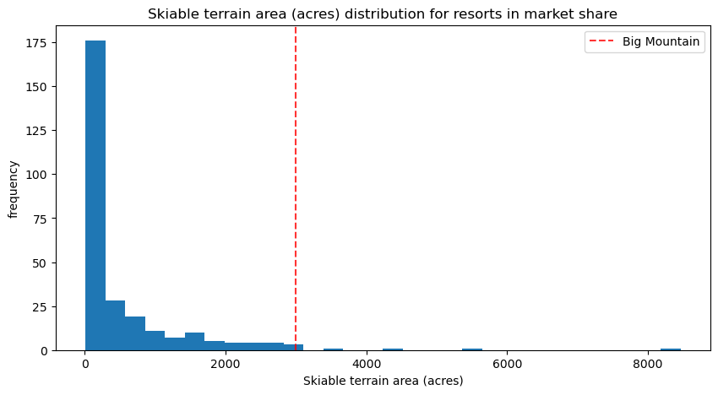
Modeling results and analysis
Despite being half the length of the longest run,
they have one of the longest run.
Big Mountain ranks amongst the highest in runs.
Like Big Mountain, most resorts don’t have a tram.
Big Mountain has one of the largest amount of skiable terrain.

Slide 9
Summary and Conclusion
We calculated the expected ticket price for Big Mountain Resort using our model, which yielded a mean absolute error of 10.39 dollars. This suggests there is potential to increase the ticket price. According to our model’s predictions, the ideal ticket price for Big Mountain Resort should be $95.87.
When comparing Big Mountain Resort to other resorts, its ticket price is slightly above the median but remains one of the highest in Montana. Despite this, it boasts significant features: one of the largest vertical drops, extensive snow making coverage, and three fast quad lifts. It also has a considerable number of runs and some of the longest runs available. Although it lacks trams, this is typical among many resorts. Overall, Big Mountain Resort has a substantial amount of skiable terrain.
To enhance the resort's offerings and potentially justify a price increase, adding an additional run and chairlift could be beneficial. This improvement would increase the vertical drop by 150 feet and is expected to raise the ticket price by 1.99 dollars . Over the course of the season, this change could generate an additional revenue of approximately 3,474,638 dollars.

